Slide 1



PROJECT ON ANALYTICS
Akash Mukherjee
ID: AF0434713
Batch: ANP-8484
Guide: Khushbu Thakur

Slide 2




Project Problem
Problem Statement
Nitin works as a Graphic Designer in a new company. He earns Rs. 15,000/- per month. He is planning to buy a scooter for his daily commute to the office.
For the last couple of months, Nitin is not able to save at all for his scooter. His friend Ayush told him that he needed to figure out where most of the money goes and cut down that expense.
Help Nitin increase his savings by removing some unnecessary expenses.
www.anudip.org
FOLLOW US ON:

Slide 3
Tasks
Expense details for June
The category with the highest expense amount
Total expense amount against entertainment and shopping
Number of times Nitin has ordered food online and the amount spent for it
Number of times Nitin has watched a movie
The less essential category that Nitin may remove to increase his savings
How much is spent for each category (Pivot Table) & Visually represent the amount spent against each category is what percentage of the total expense amount (Pivot Chart)
How much is spent on different items of each category (Pivot Table) & Visually represent the amount spent on different items of Entertainment and Tickets and bills category (Pivot Chart)
How many times money has been spent against different items of each category (Pivot Table) & Filter the data to display the data for Grocery items and Shopping items
What amount is spent on each item of the categories with highest and 2nd highest expense amount (Pivot Table) & Visually represent the data with data bars (Conditional formatting)

Slide 4

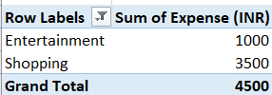


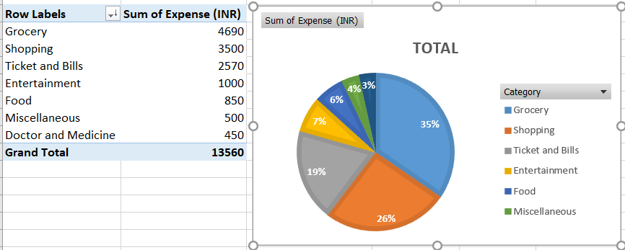
Answers (Expense details for June)
Task 1
Task 3
Task 2
Task 5
Task 4
Task 6

Slide 5
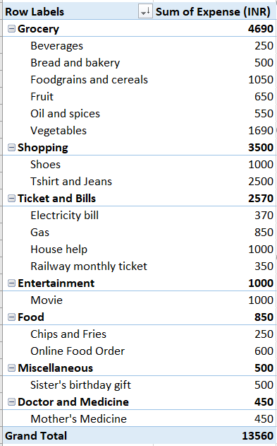
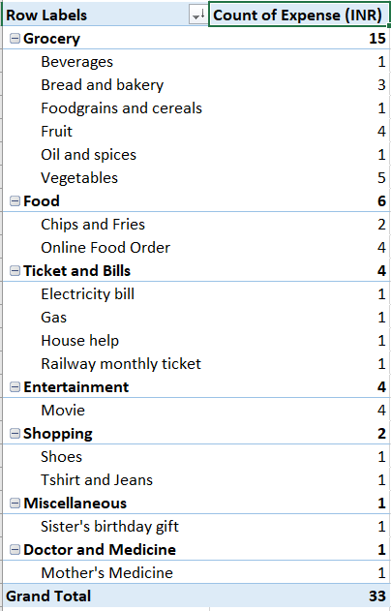
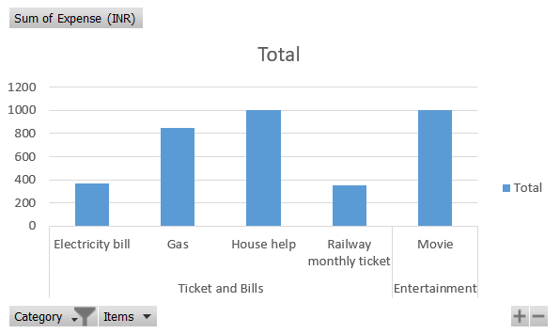
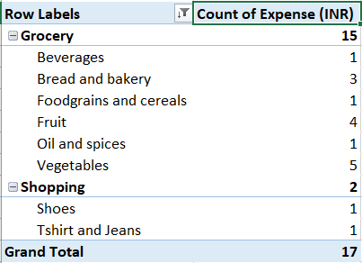
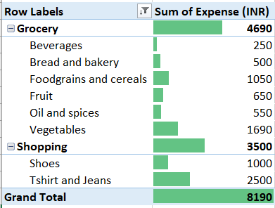
Answers (Expense details for June)
Task 8
Task 7
Task 9

Slide 6
Tasks
Expense details for 6 months
The month-wise trend of expenses and find out the month Nitin spent the most
Visual representation of expenses against different categories
Top 2 categories with higher expenses for each month
Recommendations on how can Nitin increase his savings
Month-wise trend of expenses (Pivot table and chart) & Find out the month Nitin spent the most
Category wise expenses (Pivot table) & Visually represent it with data bars to display categories with the highest and lowest expense amount
Month-wise expense of each category (Pivot table) & Find out 2 categories with higher expenses for each of the 6 months
How much is spent in each month against different items of Entertainment, Food and Shopping categories (Pivot table) & Find out which months have the highest amount spent for movies and dining out
Decide on the essential and less essential items and analyse the expenses & Recommend how can Nitin increase his savings

Slide 7
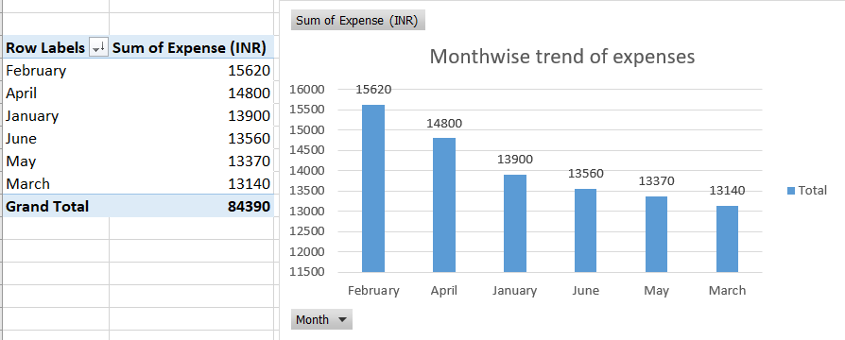
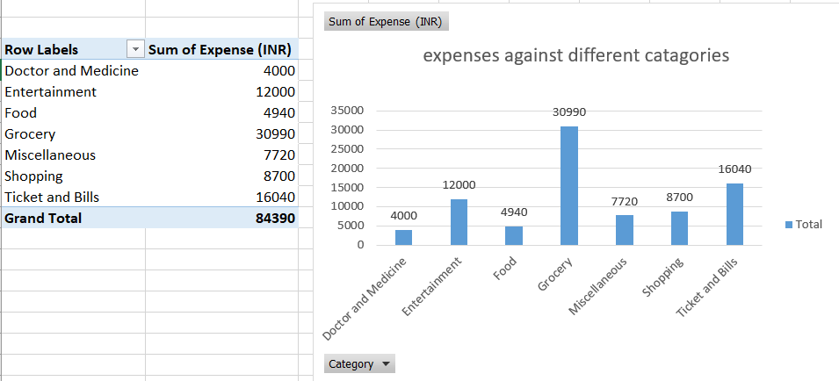
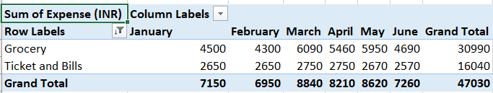
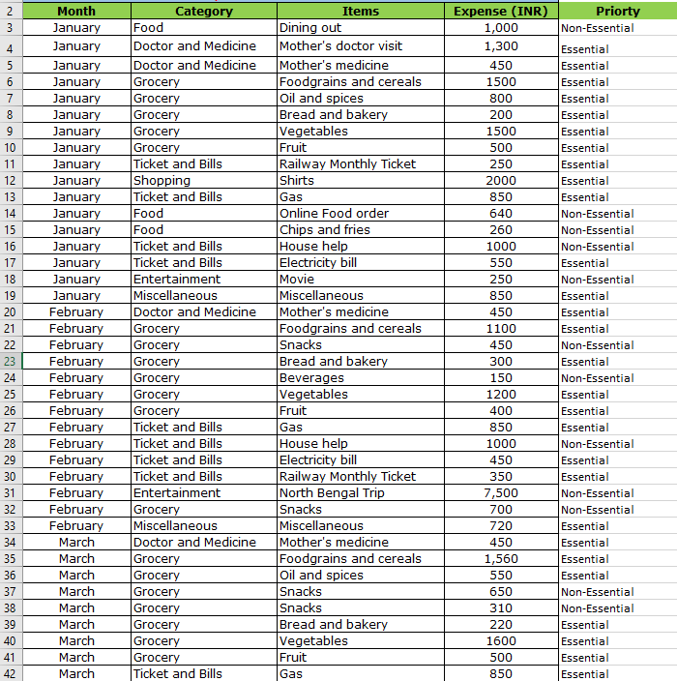
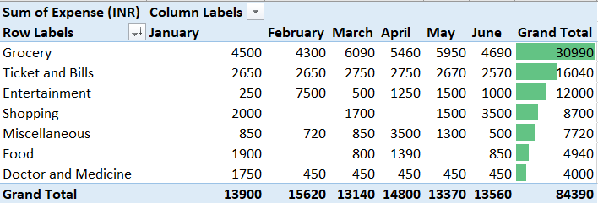
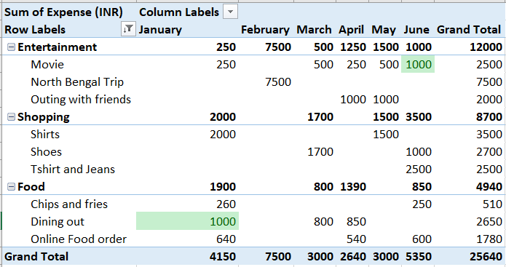
Answers (Expense details for 6 months)
Task 3 & Task 7
Task 1 & Task 5
Task 2 & Task 6
Task 6 & Task 7
Task 8
Task 9

Slide 8
Answers (Expense details for 6 months)
Task 9 & Task 4:
Analysis to increase savings
Savings Strategy for Nitin
1. Reduce Dining Out and Online Food Orders
Cook at Home: Prepare meals in bulk to reduce costs.
Pack Lunches: Bringing lunch to work or school saves money and is healthier.
Savings Estimate: ₹10,000 (6 months)
2. Limit Snack and Beverage Purchases
Healthy Snacks: Choose fruits, vegetables, and nuts over processed snacks.
Scheduled Snacks: Control portion sizes and stick to planned snack times.
Savings Estimate: ₹5,380 (6 months)
3. Cut Entertainment Expenses
Free Activities: Opt for parks, community events, or movie nights at home.
Limit Trips: Scale down the February North Bengal trip or plan budget-friendly alternatives.
Savings Estimate: ₹10,000 (6 months)
4. Mindful Shopping
Budgeting: Set monthly shopping budgets and avoid impulse buys.
Second-hand Shopping: Consider buying pre-owned items.
Savings Estimate: ₹3,000 (6 months)
5. Review Miscellaneous Expenses
Cut Non-Essentials: Prioritise spending, reduce gifts, and negotiate costs for services like house help.
Savings Estimate: ₹5,350 (6 months)
Total Estimated Savings for Nitin: ₹33,730
By adopting these strategies, Nitin could save over ₹33,000 in just six months!
Breakdown of Estimated Savings for Nitin (January to June)
Dining Out and Online Food Orders: ₹10,000
Snacks and Beverages: ₹5,380
Entertainment (Movies, Trips, Outings): ₹10,000
Shopping (Mindful and Second-hand): ₹3,000
Miscellaneous Expenses (House Help, Gifts): ₹5,350
Grand Total Estimated Savings: ₹33,730

Slide 9


